Slide 1

PREDICTIVE MAINTENANCE
for FOOD AND BEVERAGE INDUSTRY
© 2012-2020 Innodatatics Inc. All Rights Reserved.

Slide 2










Hrishikesh Mahadev
Madhu
Neha Ali
Karthik
Partik
Upendra
Padala Rakshita Naidu
Jyotsna Pandey
Koukuntla Aishwarya
Prasanna Guntupalli
© 2012-2020 Innodatatics Inc. All Rights Reserved.

Slide 3










Meghal Agarwal
Tejaswi Tadikonda
Chetan Khapekar
Mohammed Shajiuddin
Gazala Zareen
Ramya Vellakatta
Tathagat Sinha
Sruthi Penta
Nikki Sharma
Sai teja
Pavan Marella
© 2012-2020 Innodatatics Inc. All Rights Reserved.

Slide 4
EFFORT
Milestone | Tentative Timelines (from the date Data is provided) | Key Responsibility
Extracting the data import into python | 3 days | Madhu, Ramya, Prasanna, Meghal, Neha, Digbijay
EDA and Feature Engineering | 15 days | Jyotsana, Pratik, Karthik, Chetan, Digbijay, Sai Teja,Tejaswi
ARIMA / SARIMA LSTM | 15 days | Neha, Karthik Gazala, Vyishnavi, Bishu, Upendra Rakshita Naidu, Tejaswi, Venu Malarvizhi, Chandan, Prathiba Tathagat, shruthi, Mohammed, Mamta, Pawan, Meghal
Preparing Dashboard showing an alert situation | 10 days | Pratik, Nikki Shara
Code Integration | 4 days | Madhu, Karthik
Project Documentation |  | Aishwarya and Rakshita
Technical Documentation |  | Ramya, Tathagat
Error Documentation |  | Gazala
Team Lead |  | Hrishikesh Mahadev
© 2012-2020 Innodatatics Inc. All Rights Reserved.

Slide 5
CONTENT
Goals and Objectives
G
01
Importing the Data
I
EDA
02
E
Machine Learning
M
03
Deployment
D
04
05

Slide 6
ORGANISATION OF PRESENTATION
HRISHIKESH MAHADEV
MADHU
KARTHIK
PRATIK
Presentation and Overview of the project
Details the
Data Import and automation
ML algorithms
Flask Deployment

Slide 7
GOALS AND OBJECTIVES
Project goals
The overall goal is to reduce the production breakdown and predict the breakdown of plant machinery for Food and Beverage Industry
Objectives
Extract real-time data to enable predictive maintenance
Carry out machine learning process for analysing trends
Predict the breakdowns
Develop dashboard for forecasting
© 2012-2020 Innodatatics Inc. All Rights Reserved.

Slide 8
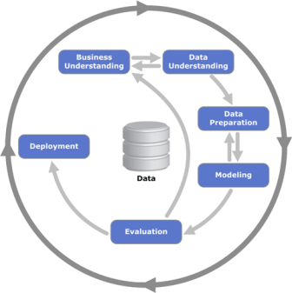
SCOPE AND ASSUMPTIONS
Scope
To extract the data from InfluxDB and read it in python
Carry out data cleaning, exploratory analysis and data transformation
Feature selection for plant maintenance
Apply machine learning algorithm for analyzing and predicting production breakdown
Present the predictive analysis results using dashboard
Assumptions
Data procured is a real time data
It is assumed that data does not contain any planned maintenance or shutdowns
The data is based on 10-days micro-second data
© 2012-2020 Innodatatics Inc. All Rights Reserved.

Slide 9
TIMELINES
EDA & FEATURE ENGINEERING
Compilation & Automation
Data Cleaning
Summary
Transformation
Feature Engineering
Compilation of all code
Add automation for inputs and outputs
link with flask
19/10
31/10
11/11
20/11
30/11
READING INFLUXDB
MACHINE LEARNING
DASHBOARD
Data readable in python
Data in data frame and .csv format
Different algorithms
Training & testing
Model accuracy
Dashboard for predictive maintenance

Slide 10
ARCHITECTURE
PYTHON ENVIRONMENT
Exploratory
Data
Forecasting
ARIMA / SARIMA
Influx DB
Deployment on Web
Input:
Output:

Slide 11
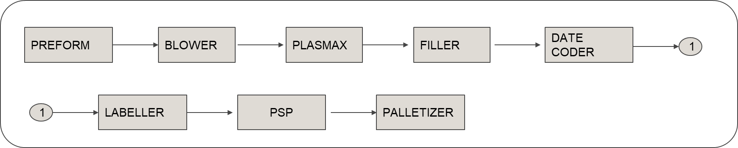
Understanding soft drink bottling process
PREFORM: Machine that produces a tube-like object.
BLOWER: The output of the above process is the input for this process. The preform object is moulded into a bottle by this machine.
PLASMAX: The machine that adds an extra glass layer to the bottle to prevent loss of carbon dioxide and vitamins.
FILLER: The machine that fills the bottles with soft drink.
DATE CODER: The machine that encodes the date of packaging on the bottles.
LABELLER: The machine that labels the bottles with brand name.
PSP: The machine that packs loose bottles in film (pad shrink packer).
PALLETIZER: Machine that stacks the bottles into cases.

Slide 12
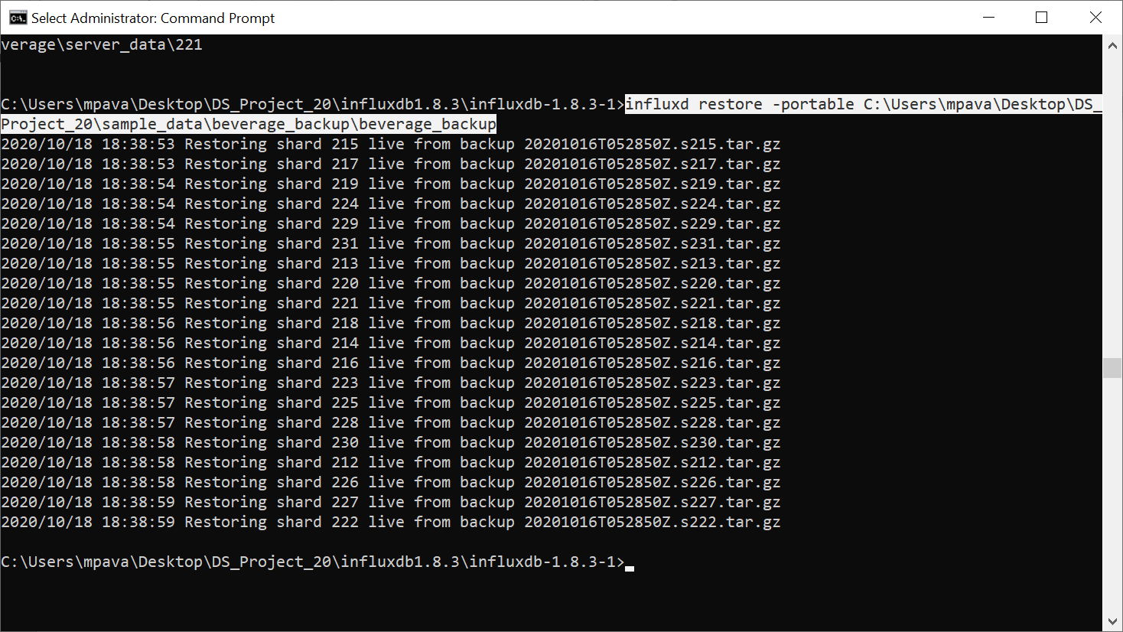
INFLUXDB
Importing the Data
Data is read using influxDB and extracted
Data has been imported into python
Converted to .csv file
Assumptions
Data procured is a real time data
It is assumed that data does not contain any planned maintenance or shutdowns

Slide 13
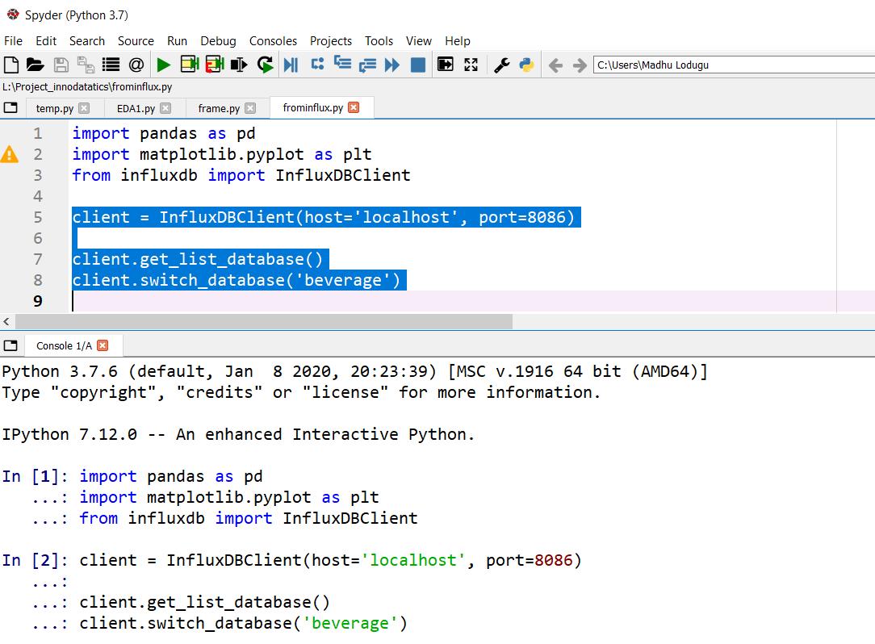
AUTOMATION OF INFLUXDB
Create a batch file (.bat)
Enter the code in the batch file to execute the python script
Verify that the batch file is working by running it (double clicking). If the batch script is running without errors, then we can go ahead with scheduling or automating it
Open Windows Scheduler in your Computer or Laptop
Schedule the batch file to run on a daily/hourly or any desired schedule

Slide 14
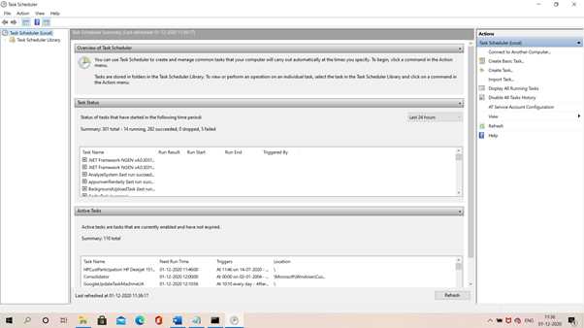

Slide 15
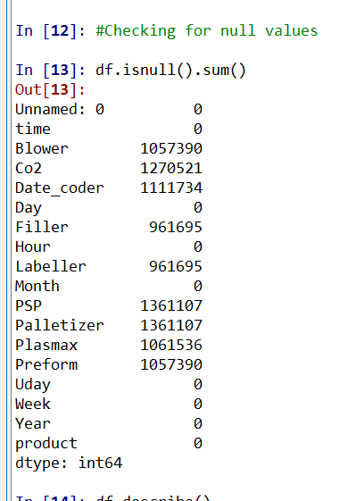
EDA and FEATURE ENGINEERING
Our dataset has 1364797 rows and 18 columns, and this is data for 10 days from 16 Aug to 26 Aug
Ignored unnecessary columns and taken only Time, Blower , Filler and Labeler in Beverage Dataframe
To get some insights from the data we have aggregated the values on Hourly basis and then plotted it

Slide 16
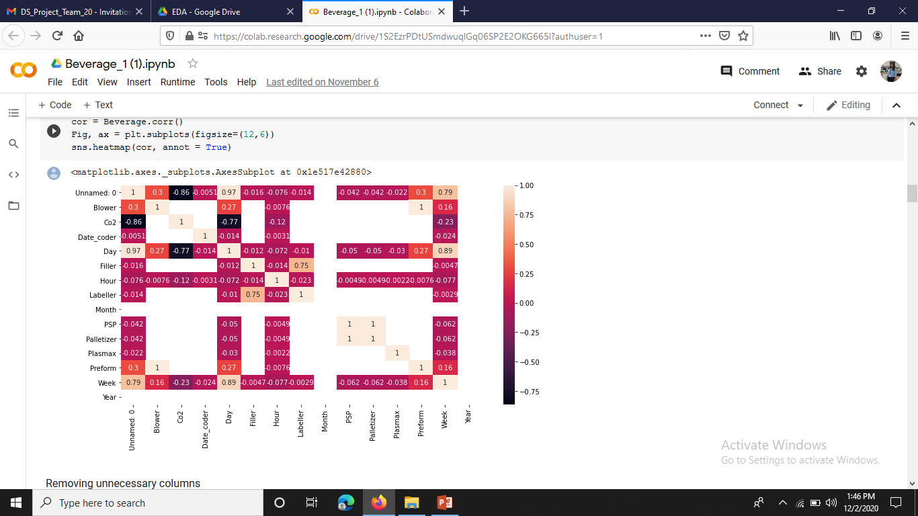
EDA and FEATURE ENGINEERING
This heatmap tells us about the correlation between the variables.

Slide 17
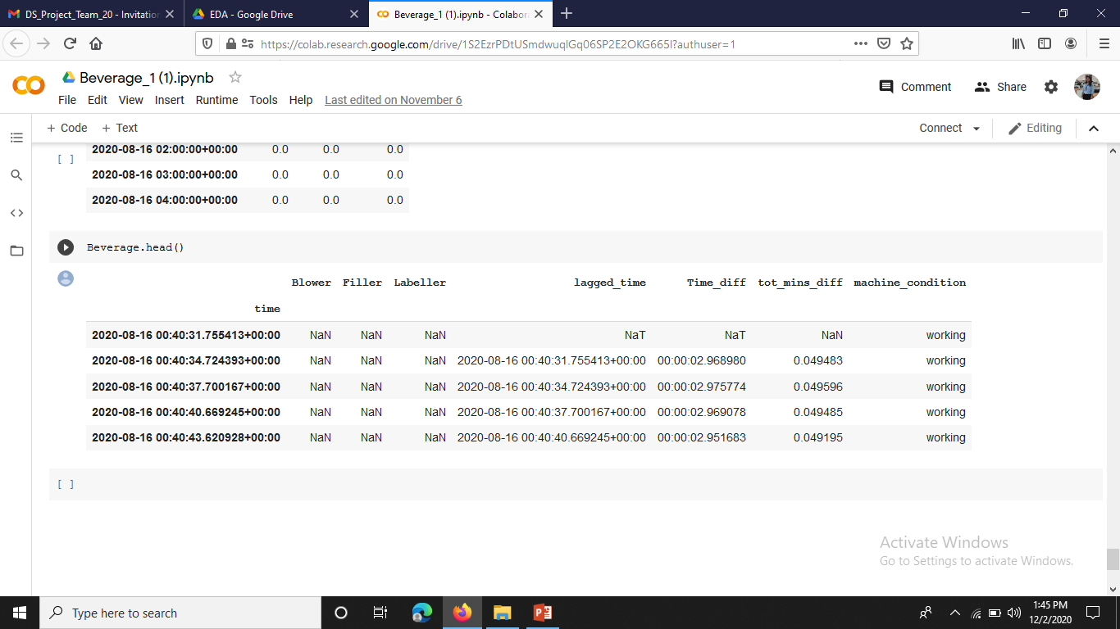
EDA and FEATURE ENGINEERING
This data is the output after the EDA and Feature Engineering. The given data tells us about the lagged time, total time difference and the machine condition, whether the machine is working or not.

Slide 18
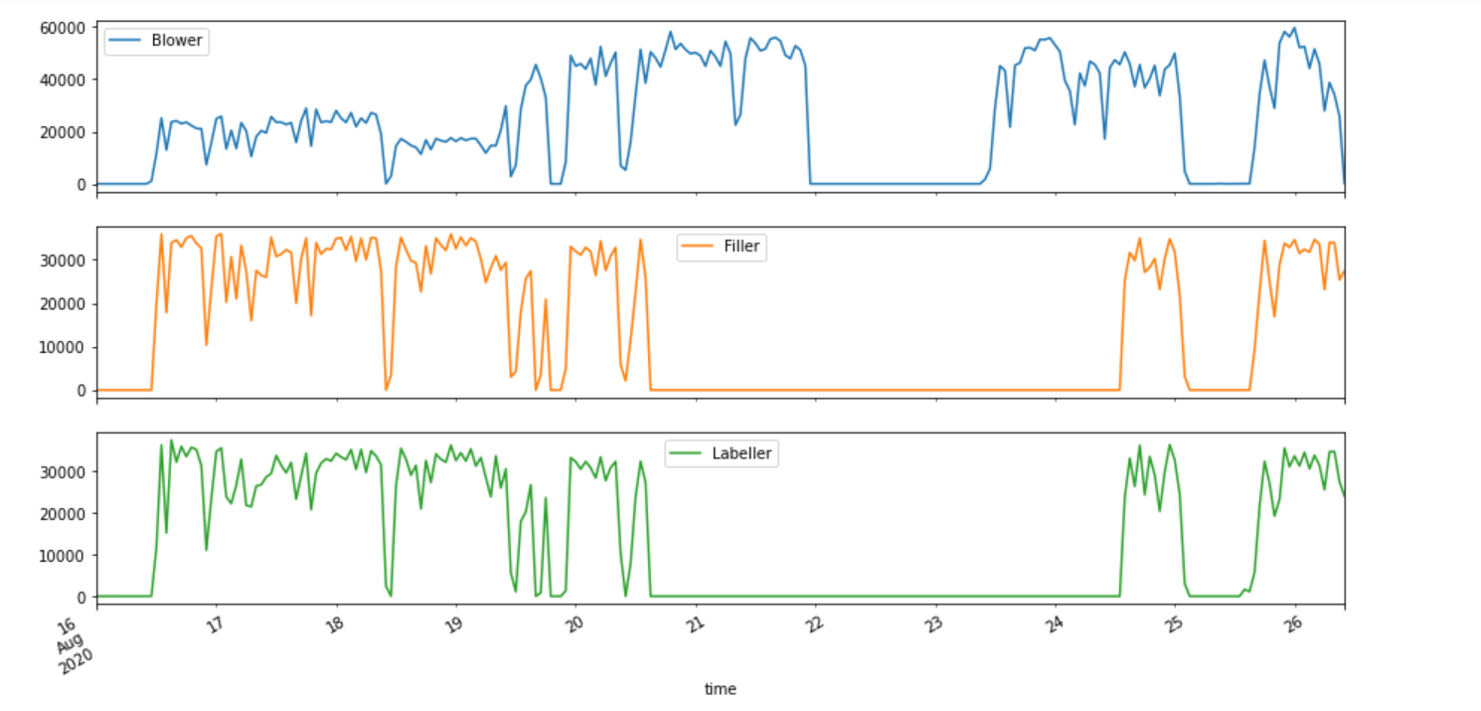
HOURLY AGGREGATED VALUE

Slide 19
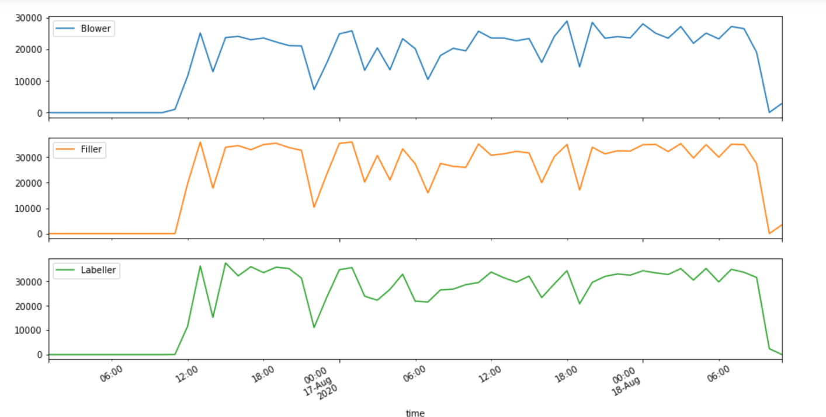
MACHINE DOWNTIME
These plots tells us about the downtime of those machines

Slide 20
EDA and FEATURE ENGINEERING
Whether data is stationary or not: the mean, variance and covariance are constant with time
The Dickey-Fuller test: It is used to determine the presence of unit root in a series, and hence help us to understand if the series is stationary or not.
Ho: It is nonstationary
H1: It is stationary
BLOWER
ADF Test Statistic : -3.956189342990467
p-value : 0.001658114347674233
#Lags Used : 0
Number of Observations Used : 250
strong evidence against the null hypothesis(Ho), reject the null hypothesis. Data has no unit root and is stationary
FILLER
ADF Test Statistic : -3.6699265266694567
p-value : 0.004556609623666537
#Lags Used : 9
Number of Observations Used : 217
strong evidence against the null hypothesis(Ho), reject the null hypothesis. Data has no unit root and is stationary

Slide 21
MACHINE LEARNING: FORECASTING
Forecasting is a technique that uses historical data as inputs to make informed estimates that are predictive in determining the direction of future trends
The SARIMA AND ARIMA Models were used to predict the values for the next 24 hours.
The model is built separately for Blower, Filler and Labeller.
Applications: Stock price prediction, E-Commerce, Retail, Weather prediction.
Pros: It can decrease costs
Cons:
Forecasting are never 100% accurate.
It can be time-consuming and resource-intensive

Slide 22
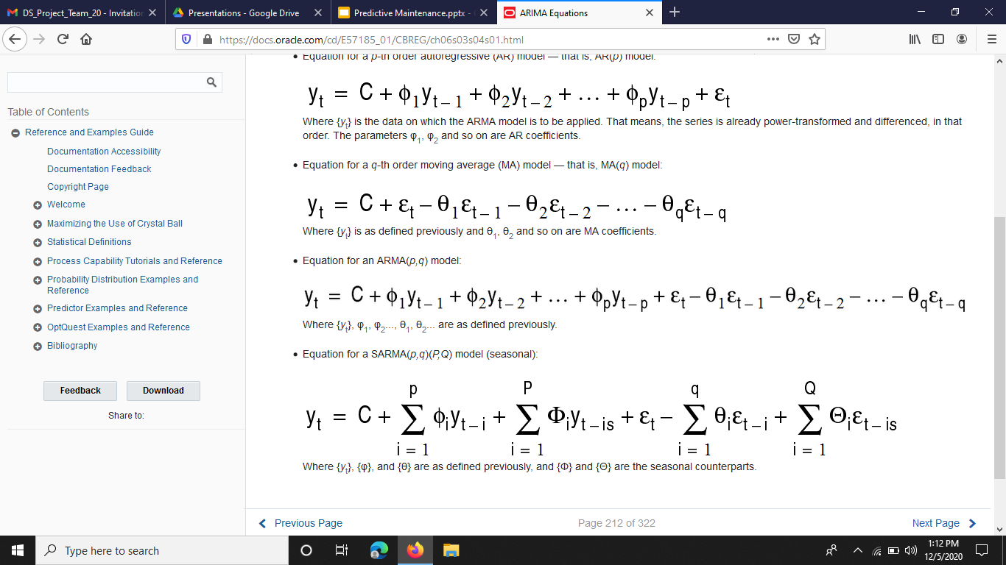
FORECASTING MODELS: ARIMA
EQUATION FOR THE ARIMA MODEL:
AR: Autoregression. This part explores any dependent relationship between an observation and some number of lagged variables.
I: Integrated. This part aims to make time-series stationery by subtracting or differencing an observation from observation at the previous time step of the same time series.
MA: Moving Average. This part explores the relationship between an observation and a residual error by application of moving average to lagged observations, with any given time window.
Trend Elements
There are three trend elements that require configuration.
They are the same as the ARIMA model; specifically:
p: Trend autoregression order
d: Trend difference order
q: Trend moving average order

Slide 23
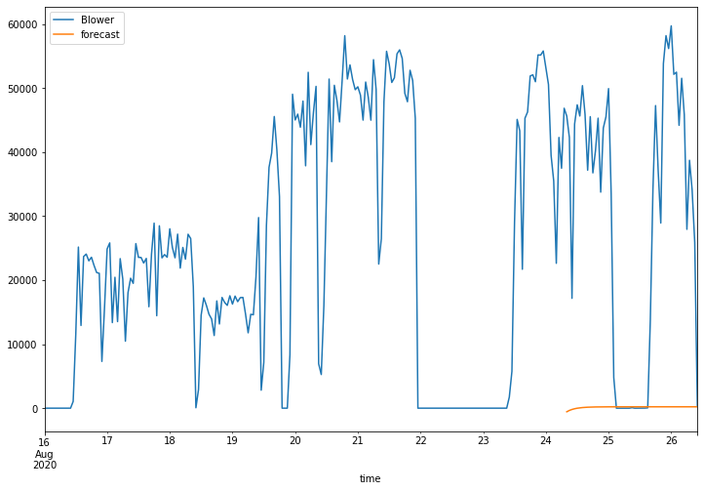
BLOWER – FUTURE PREDICTIONS
The plot shows the forecasted value for the blower for the next 24 hours.
RMSE (Test & forecast): 29109

Slide 24
FORECASTNG MODELS: SARIMA
EQUATION FOR THE SARIMA MODEL:
A problem with ARIMA is that it does not support seasonal data. That is a time series with a repeating cycle
Seasonal Autoregressive Integrated Moving Average, SARIMA or Seasonal ARIMA, is an extension of ARIMA that explicitly supports univariate time series data with a seasonal component
Seasonal Elements
There are four seasonal elements that are not part of ARIMA that must be configured; they are:
P: Seasonal autoregressive order
D: Seasonal difference order
Q: Seasonal moving average order
m: The number of time steps for a single seasonal period

Slide 25
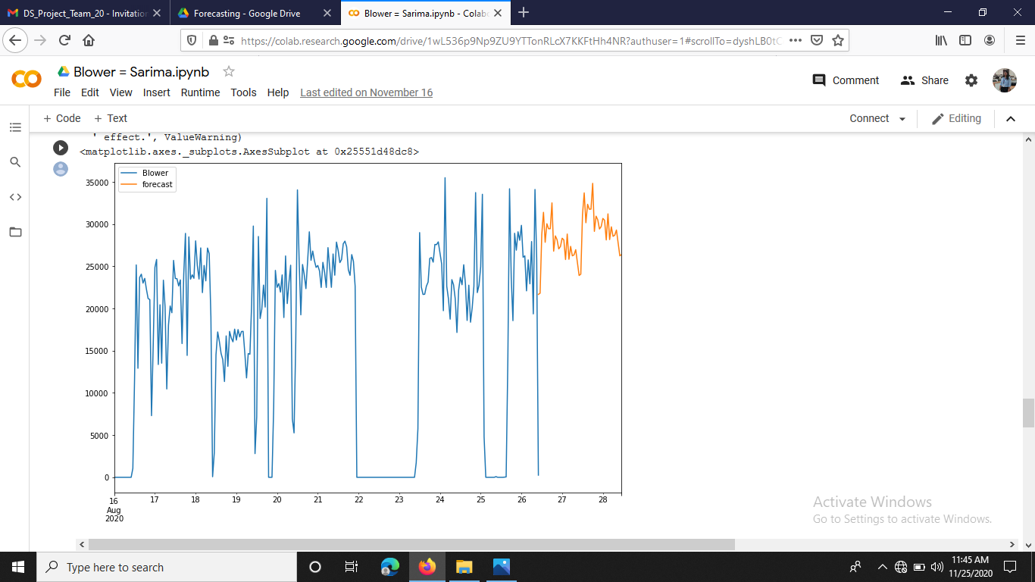
BLOWER – FUTURE PREDICTIONS
The plot shows the forecasted value for the blower for the next 24 hours.
RMSE
Training: 14729.1
Test: 13115.02

Slide 26
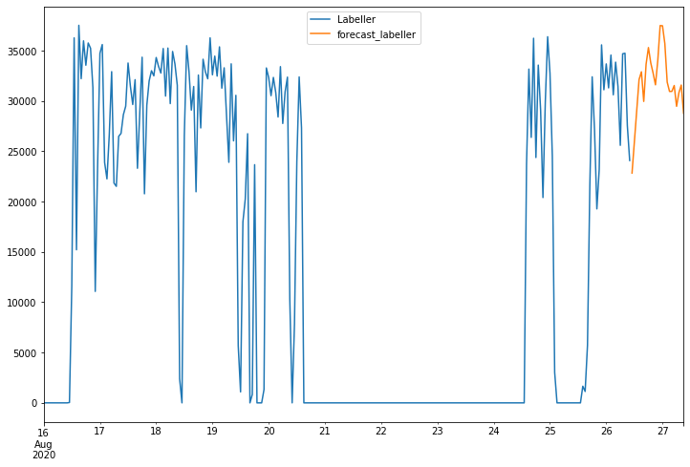
FILLER – FUTURE PREDICTIONS
The plot shows the forecasted value for the filler for the next 24 hours.
RMSE
Training: 14166.6
Test: 16194.5
Based on ARIMA and SARIMA trend
We have proposed to use SARIMA model for future prediction

Slide 27
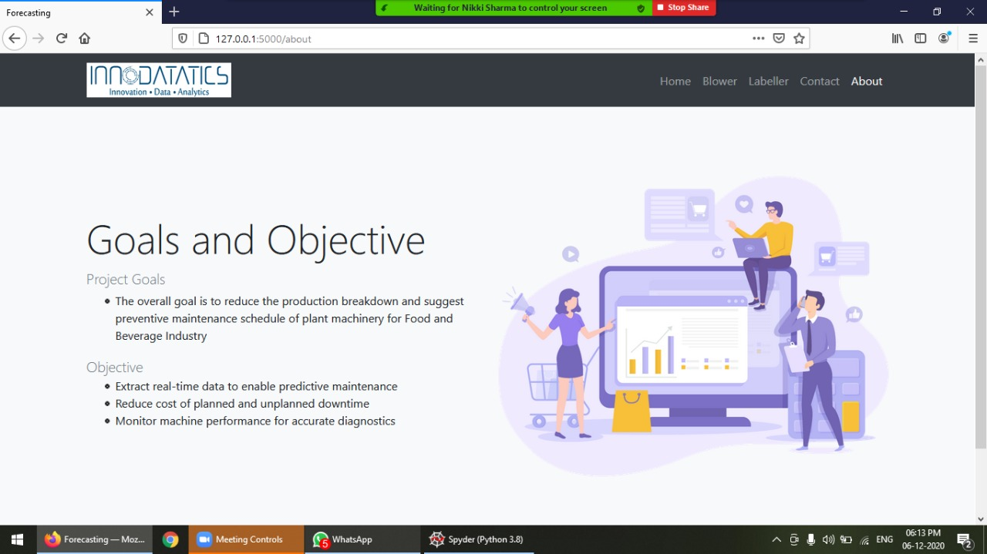
Deployment using Flask
The deployment was done using Flask where we predict blower and labeller equipment values by selecting shift-wise (8 hours) and day-wise (24 hours) forecasting time.

Slide 28
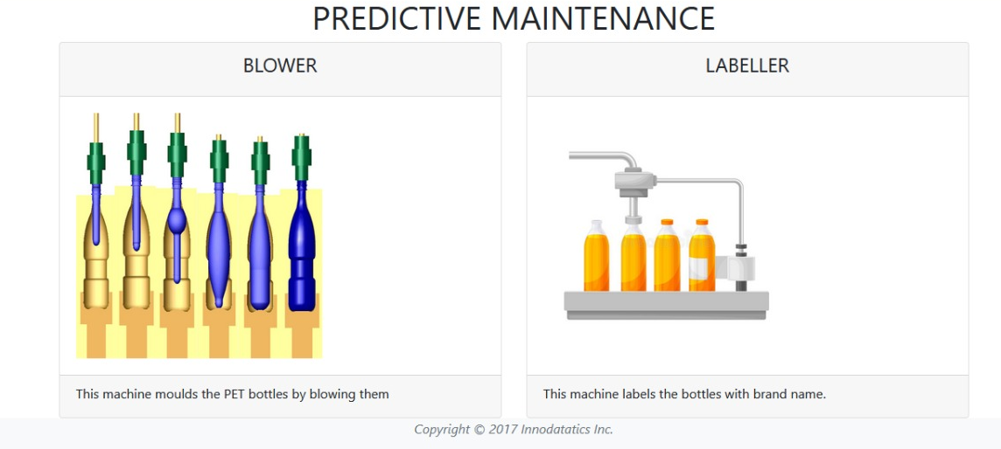
Dashboard

Slide 29
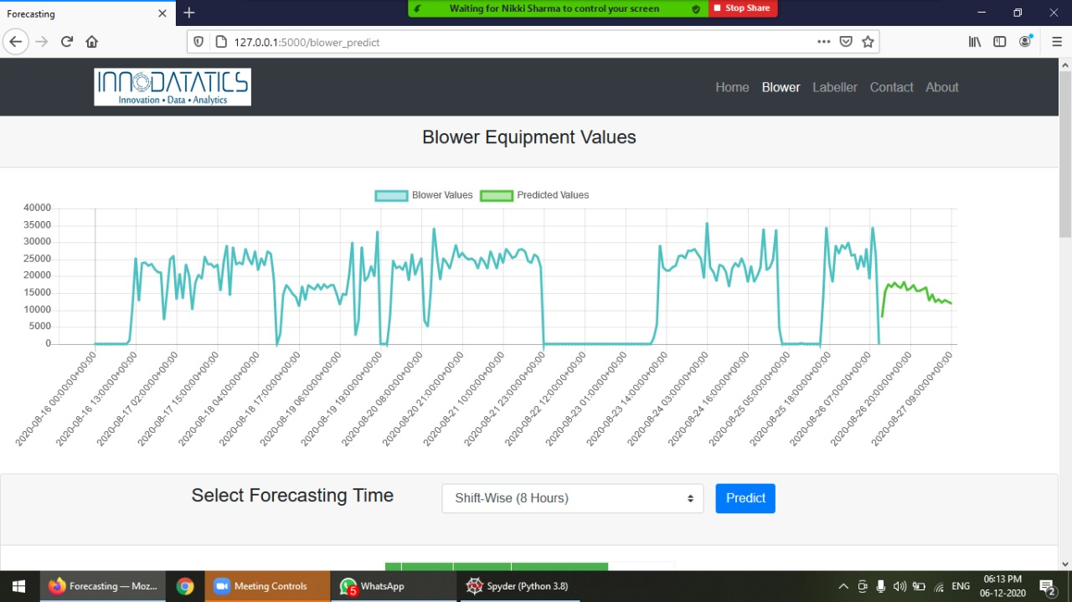

Slide 30
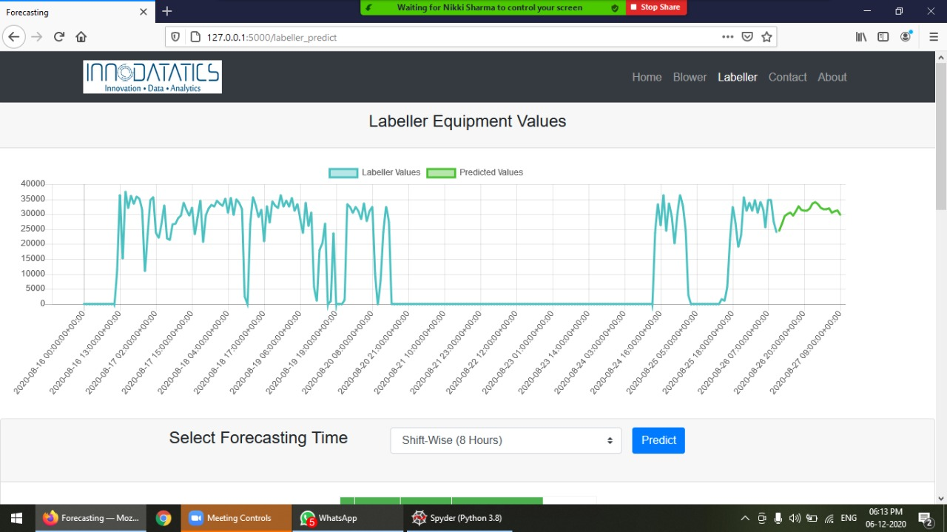

Slide 31
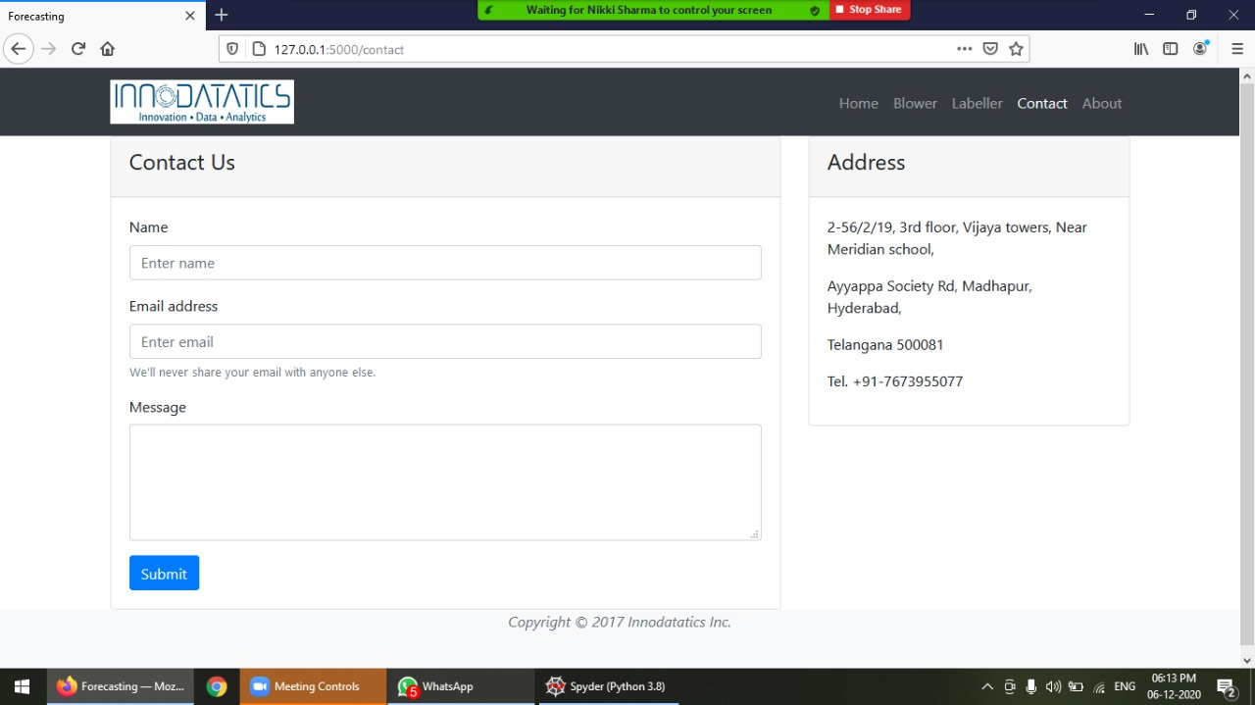

Slide 32
Thank You

